Slide 1
GeekBrains
Готовили студенты группы ПИ19-1: Содиков Фарход Гладкий Никита Касьянов Максим

Slide 2

What is GeekBrains?
It is an educational platform for IT and digital professions

Slide 3

How was it created?
In 2016 Mail Group bought 51% of shares
In 2020 Mail Group bought 49% of shares

Slide 4

Who needs GeekBrains?
A person of any age
People who want to change their profession
Who wants to start earning
Who does not know what profession to choose

Slide 5
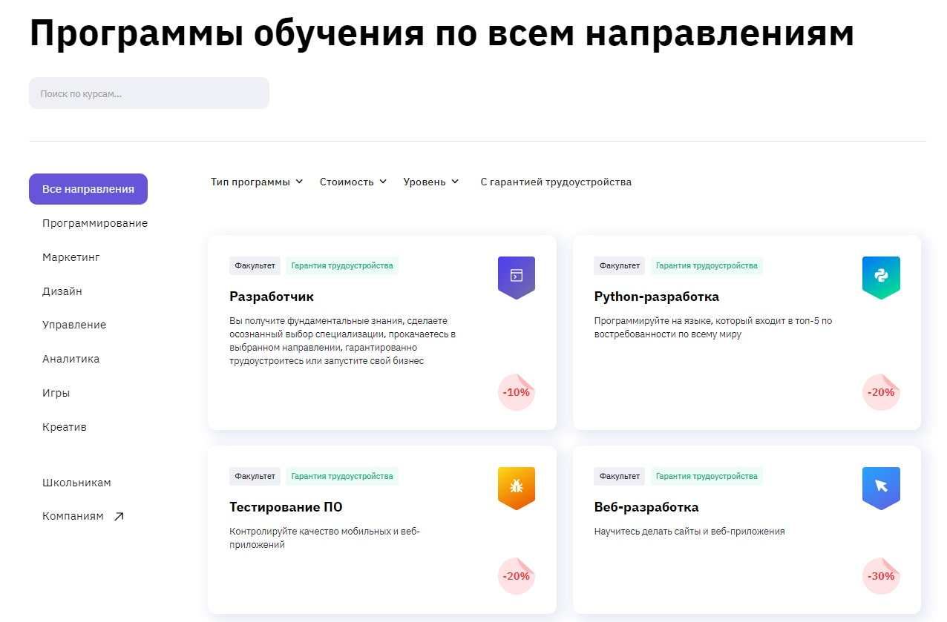
How does this educational platform work?
Choosing a training program:

Slide 6
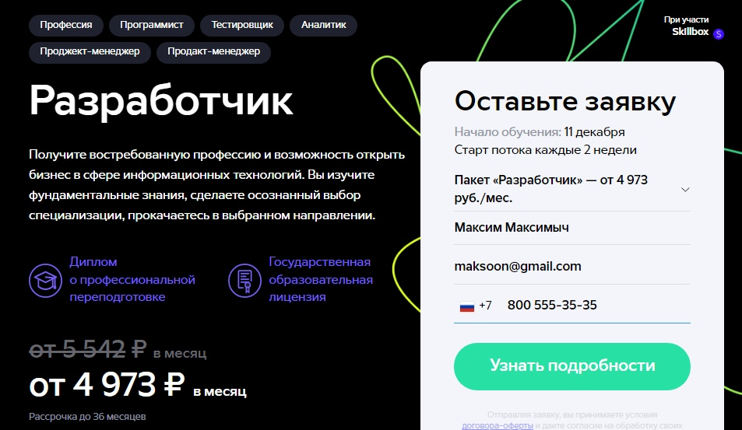
Choosing the type of program and filling out the application

Slide 7
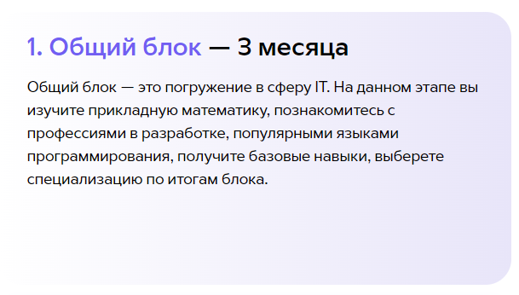
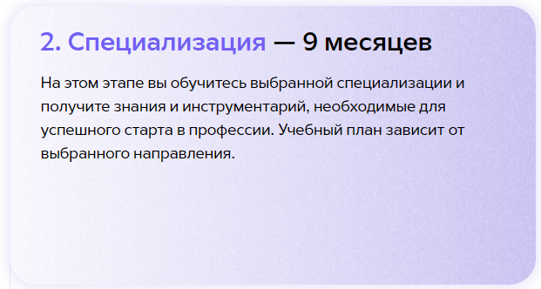
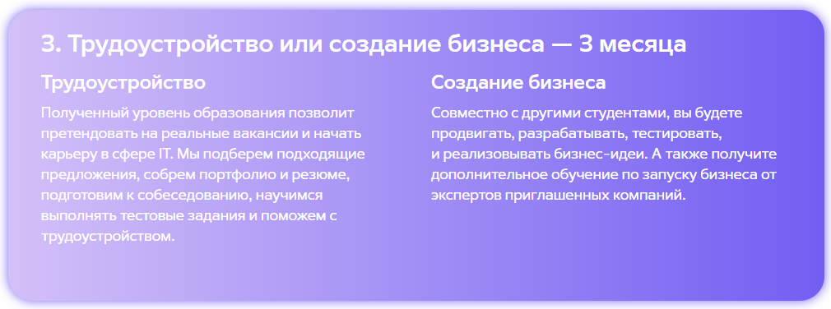
The composition of the training

Slide 8

Benefits and future abilities

Slide 9

The End

